Slide 1
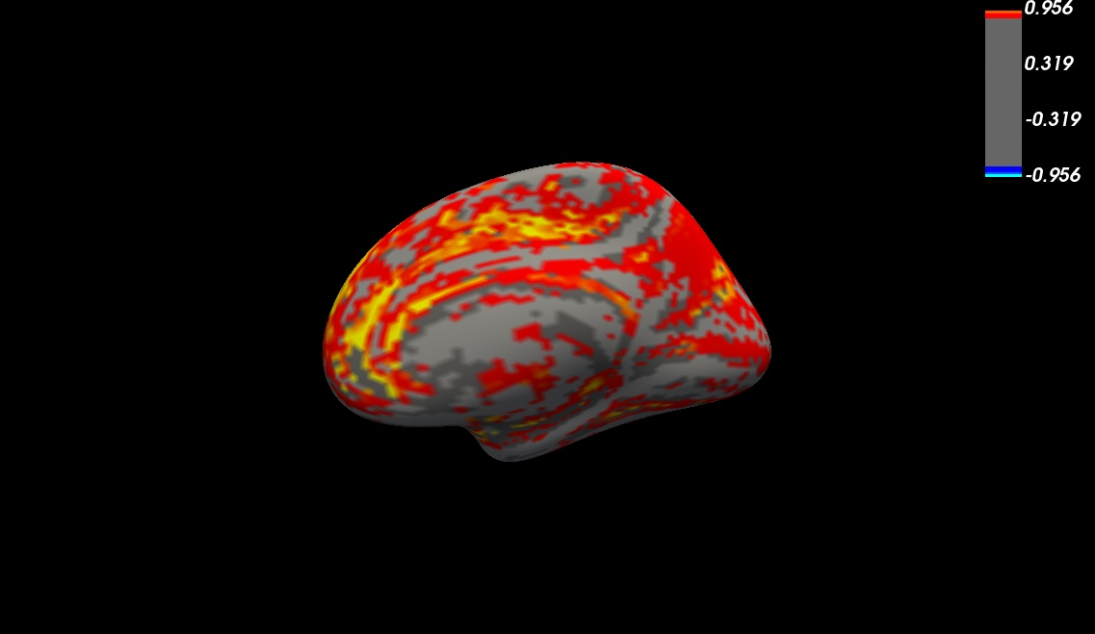
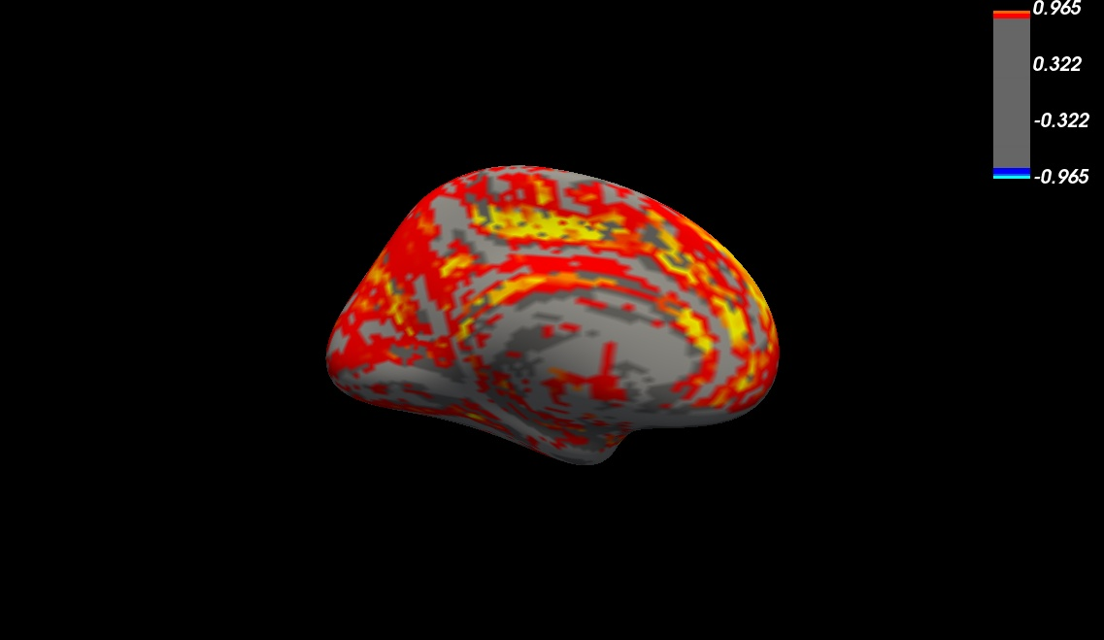
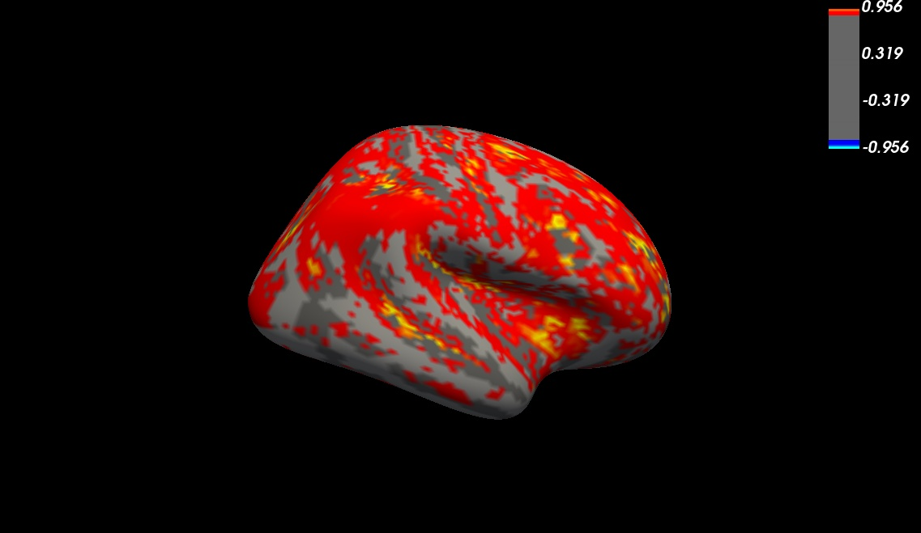
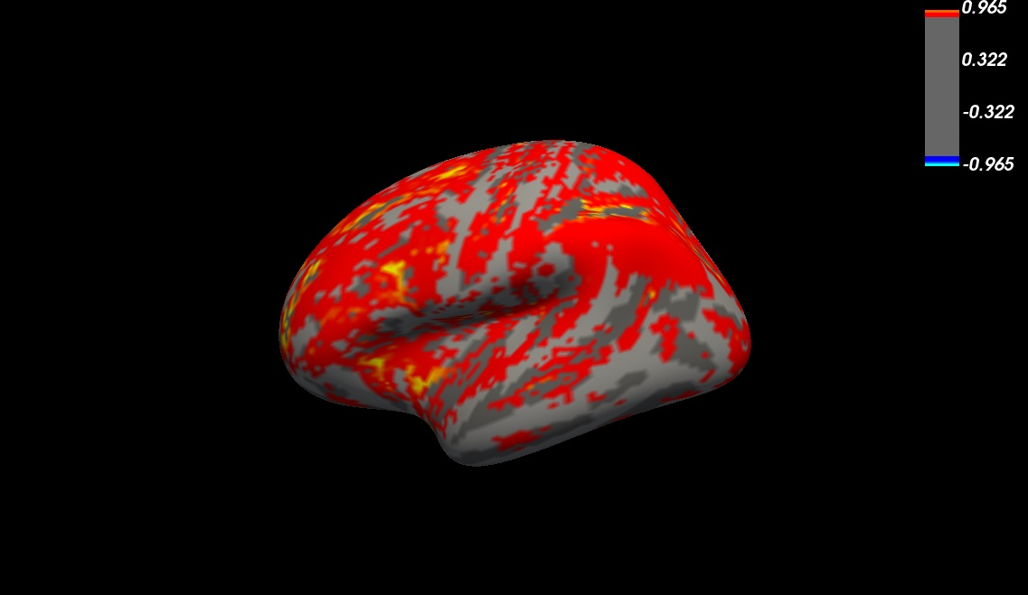
Two-modality, global wcov mean

Slide 2
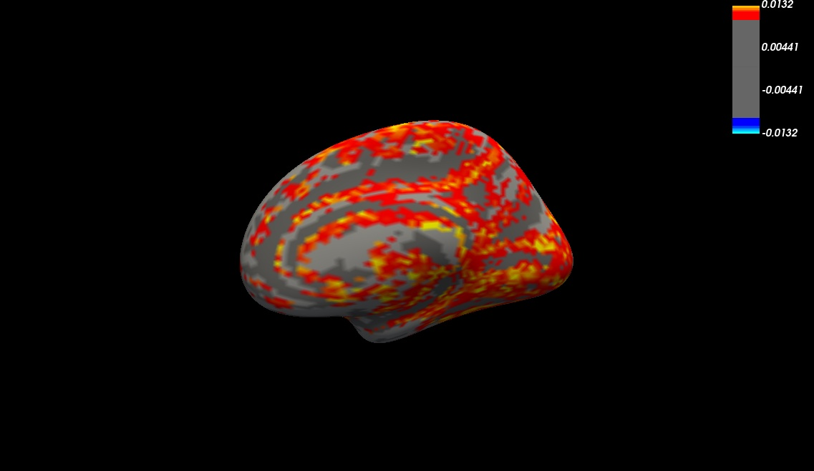
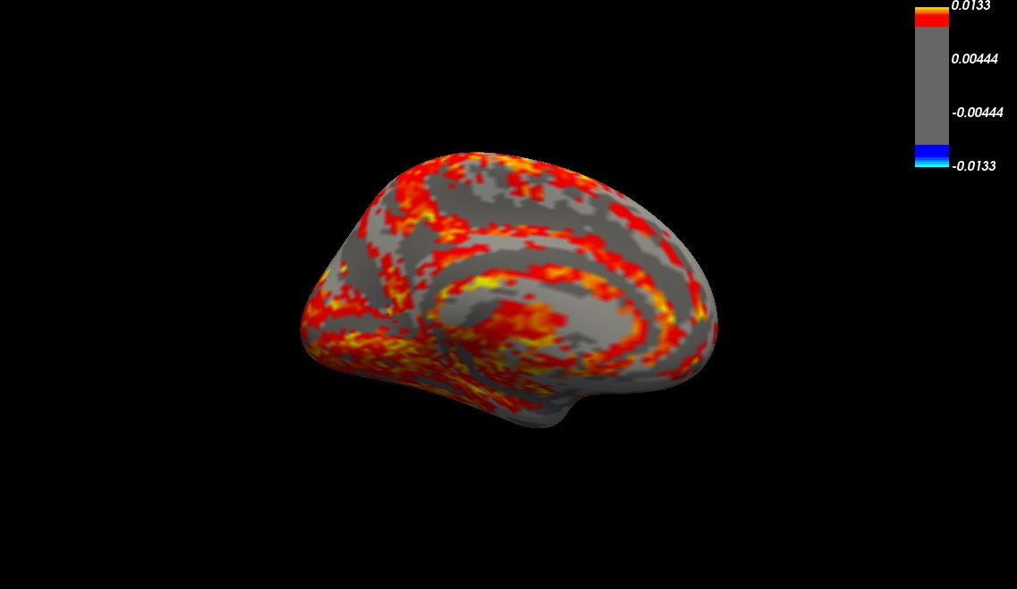
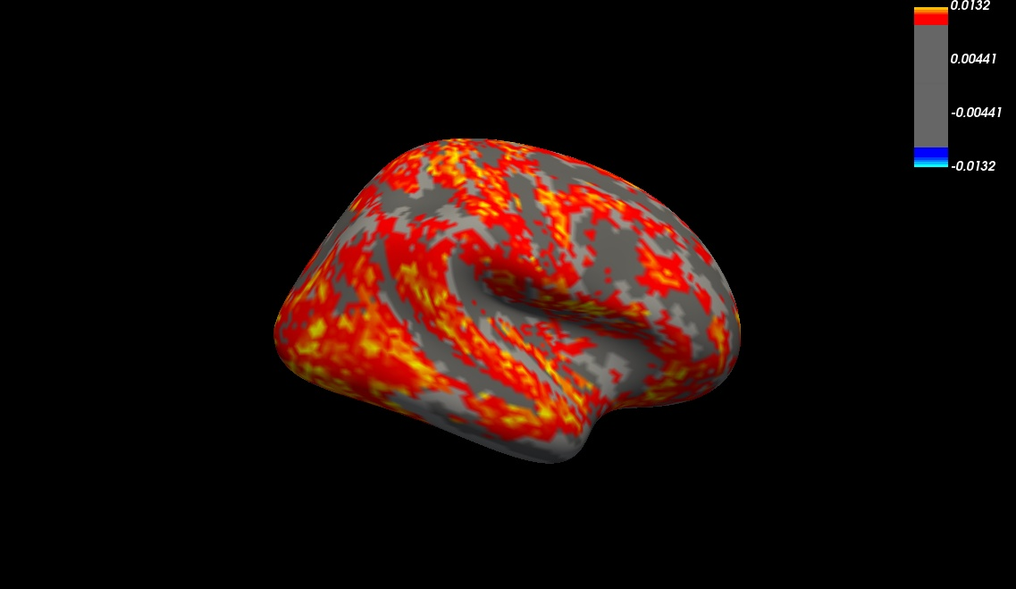
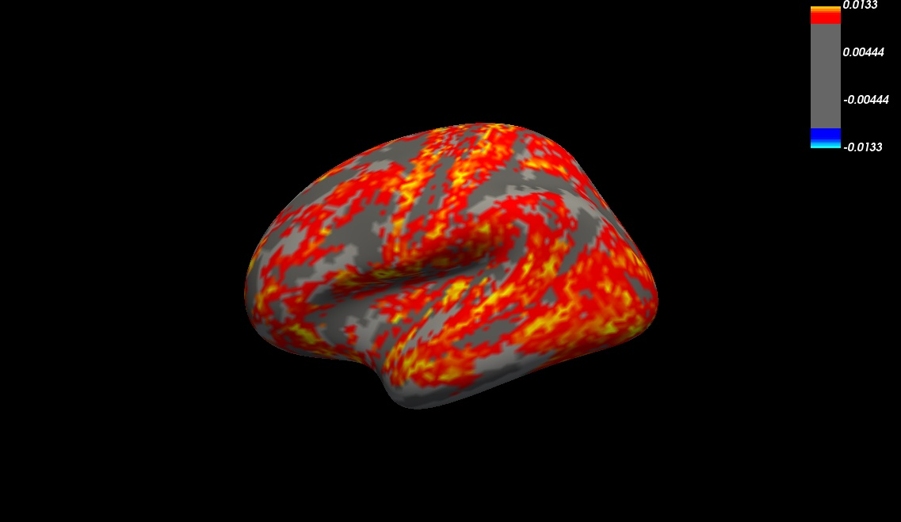
Two-modality, global wcov variance

Slide 3
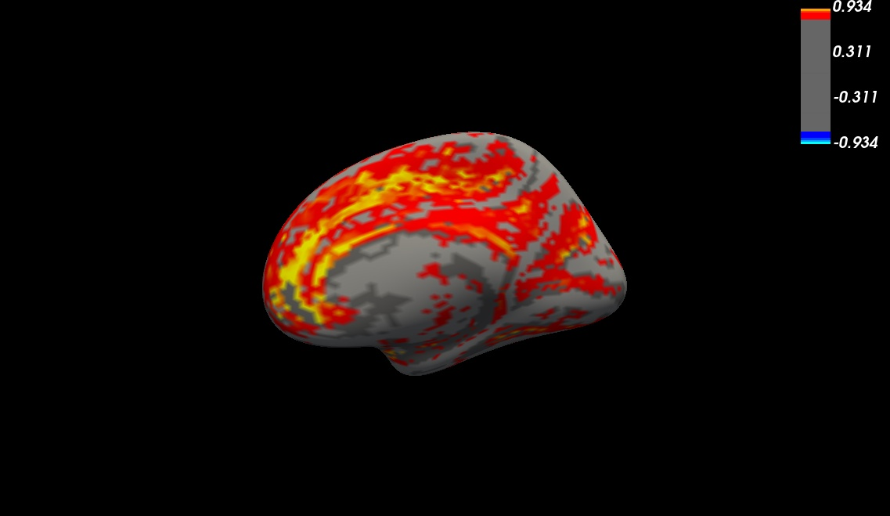
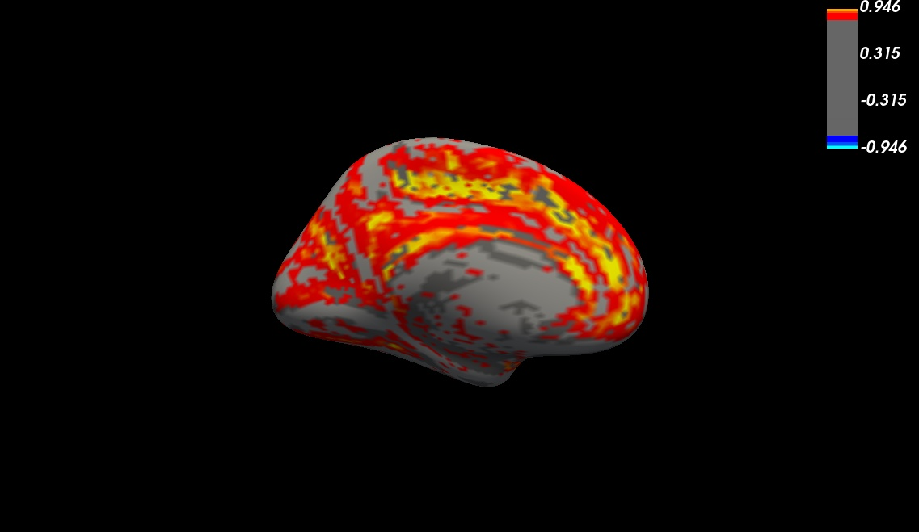
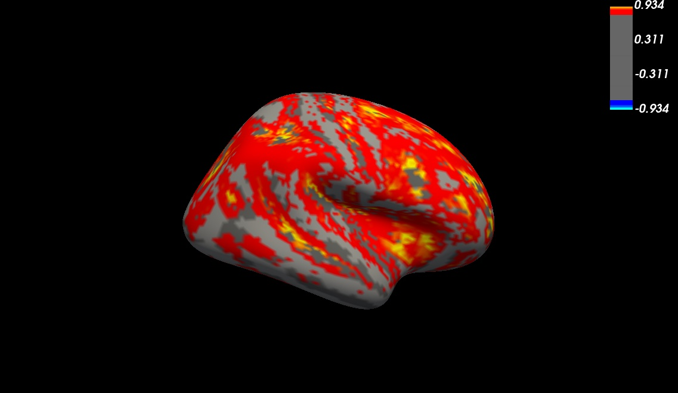

Two-modality, unscaled wcor mean

Slide 4
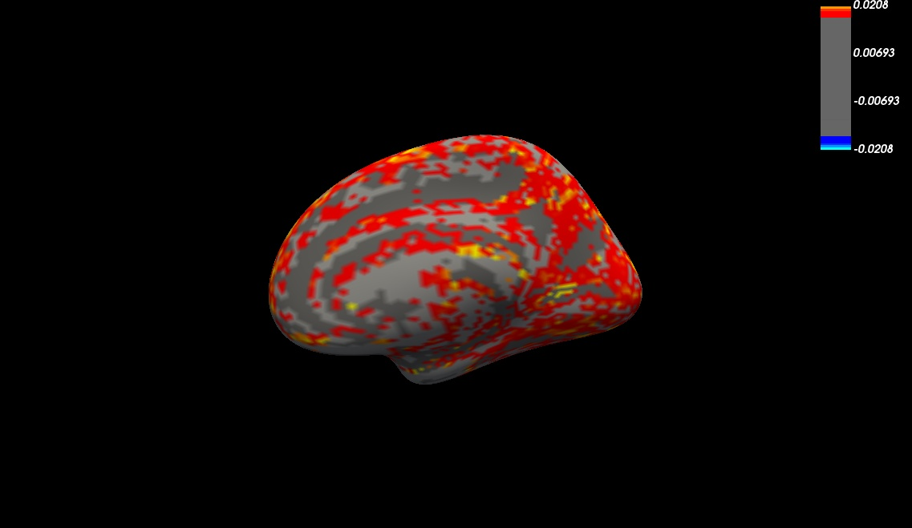
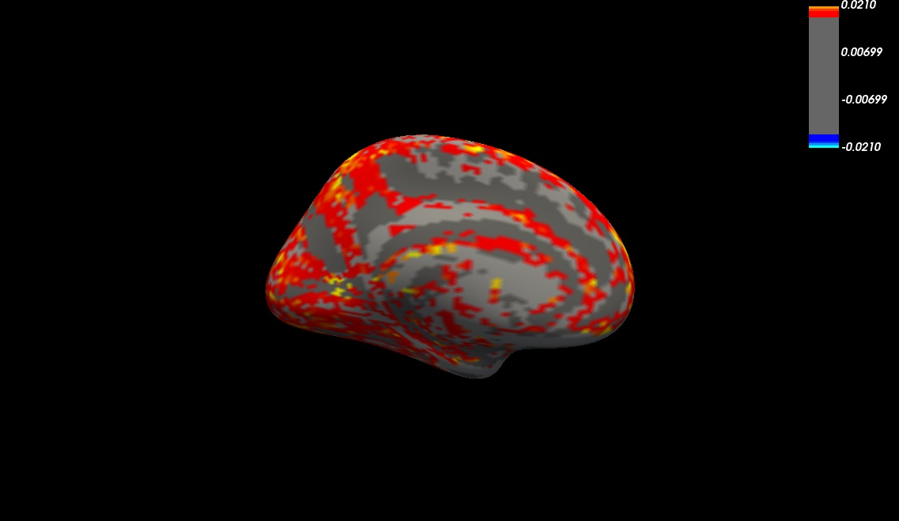
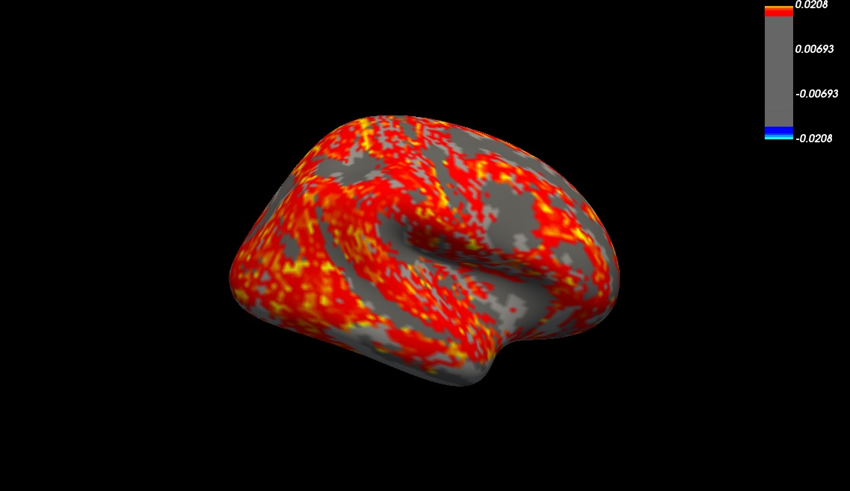
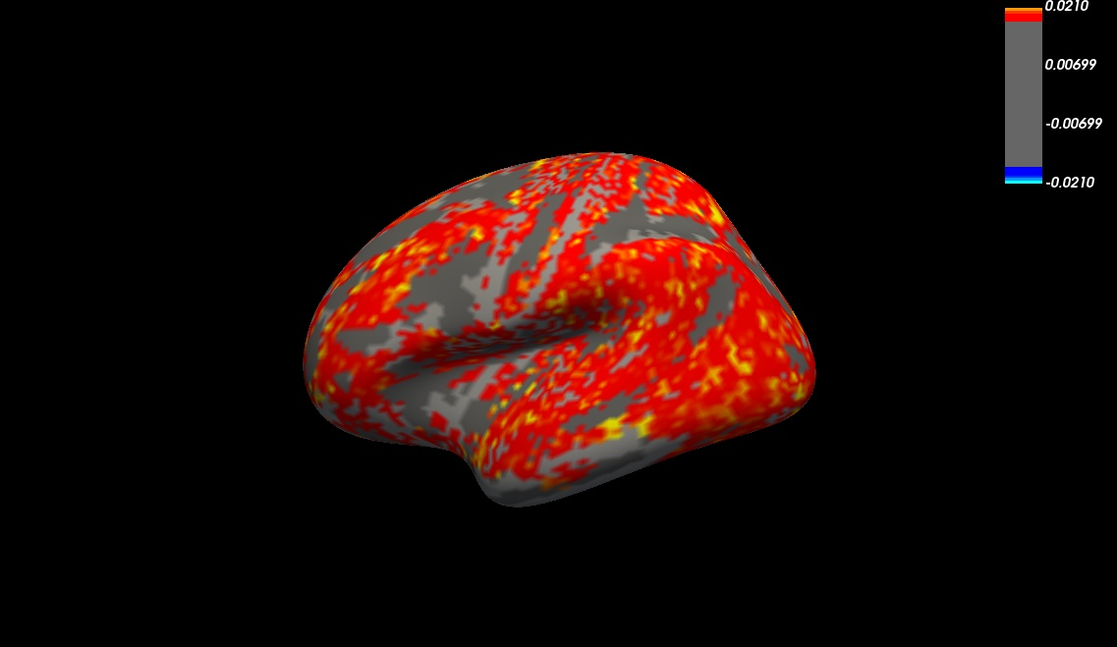
Two-modality, unscaled wcor variance

Slide 5
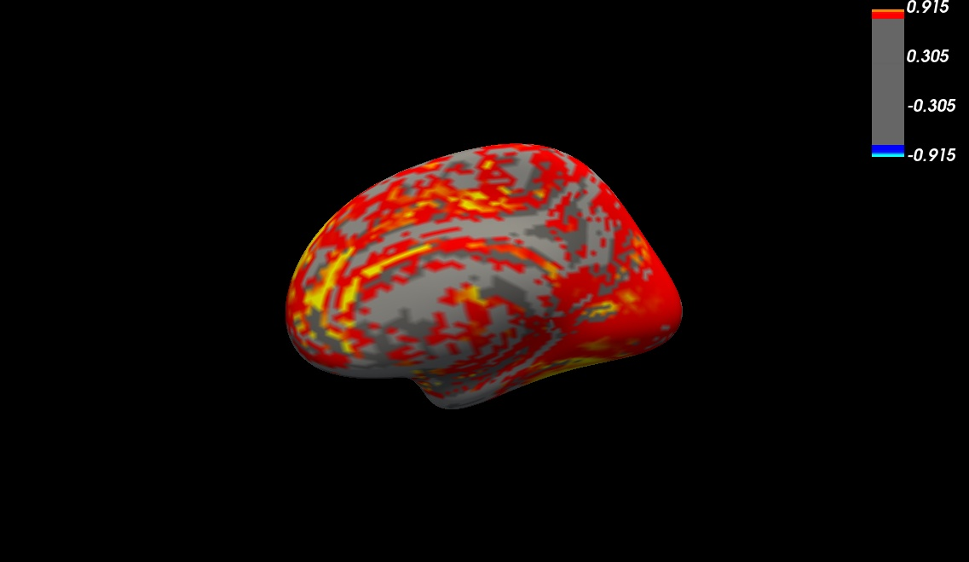
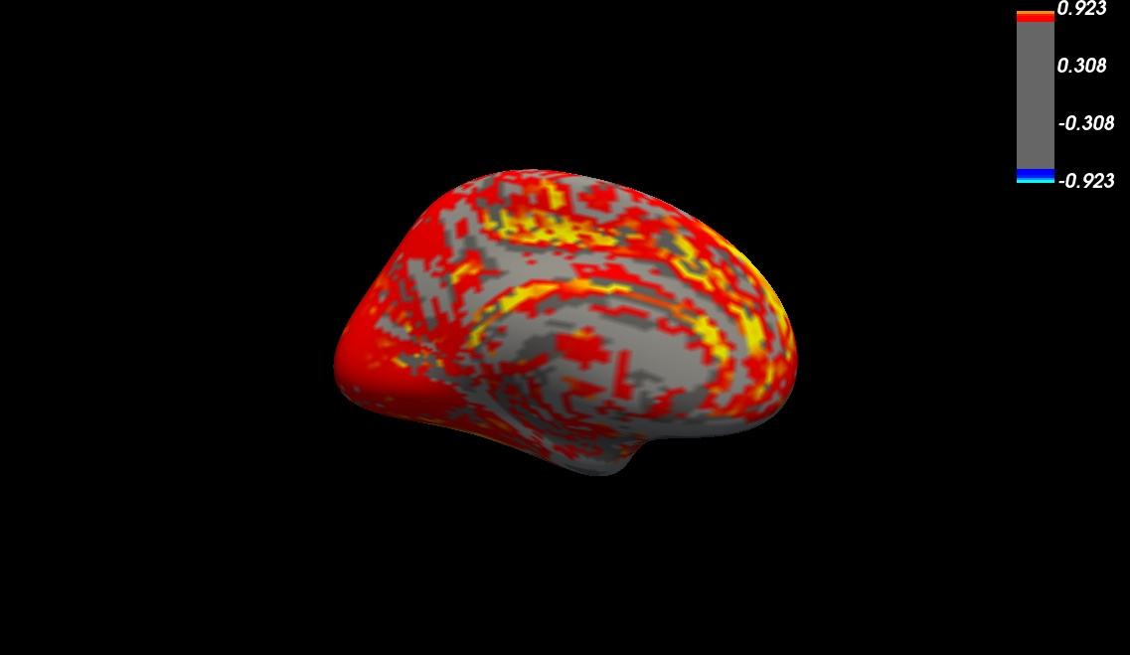
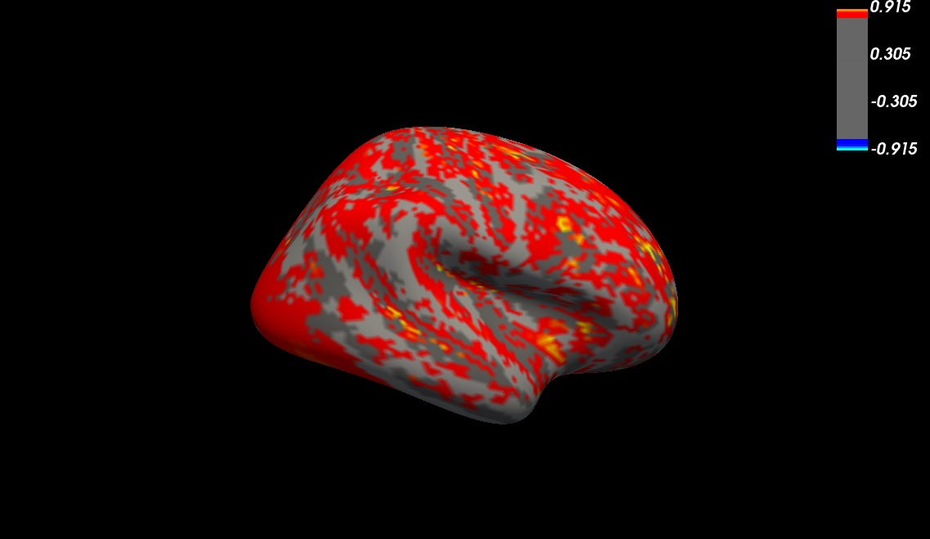
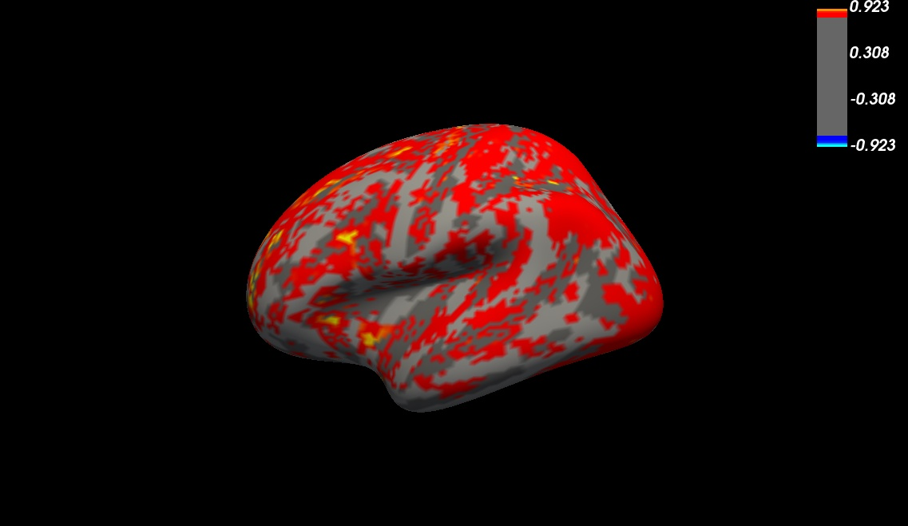
Three-modality, global wcov mean

Slide 6
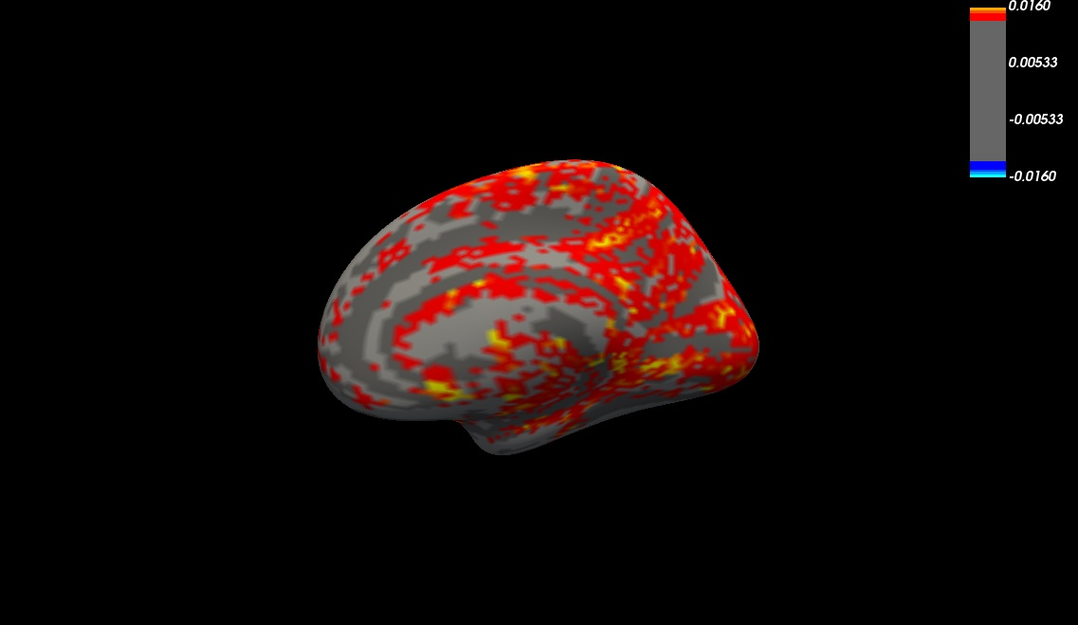
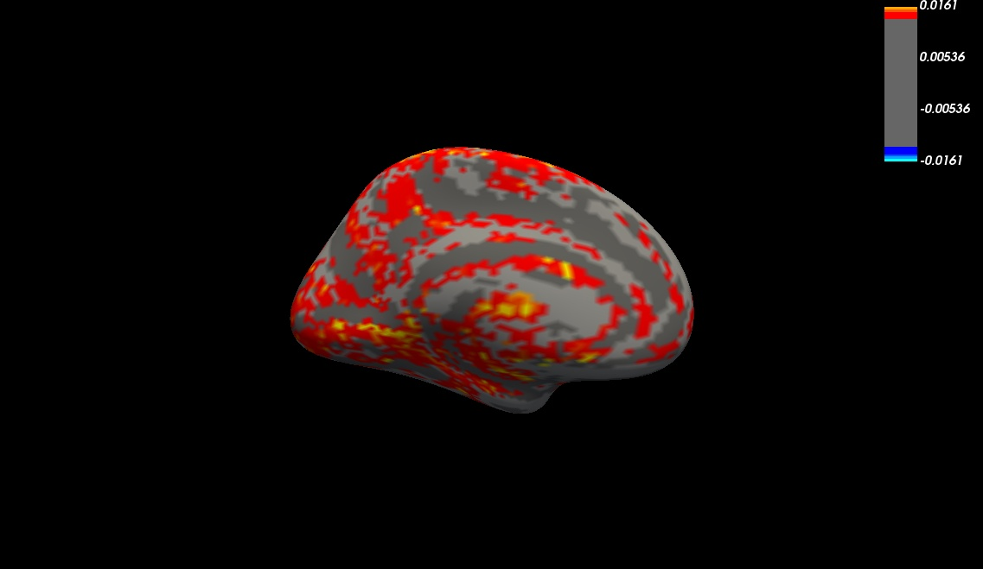
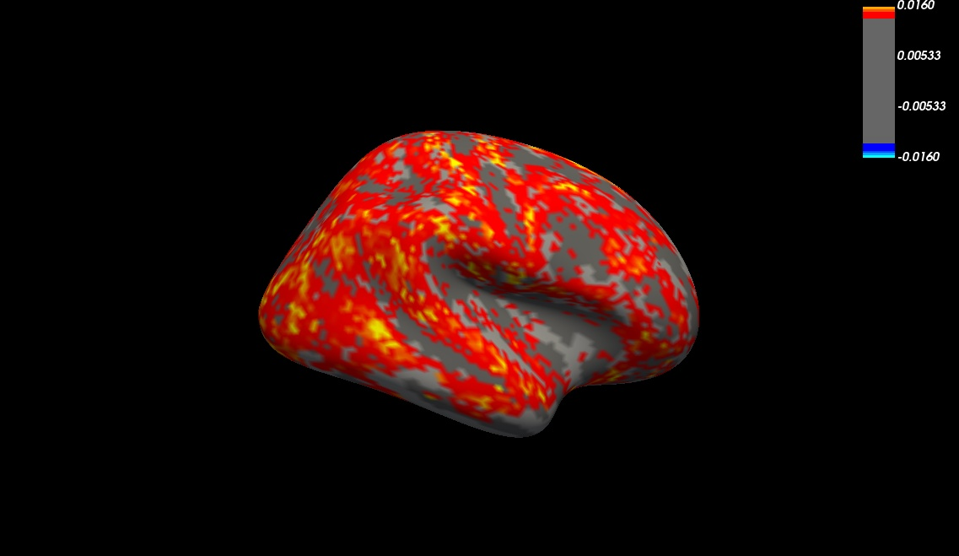
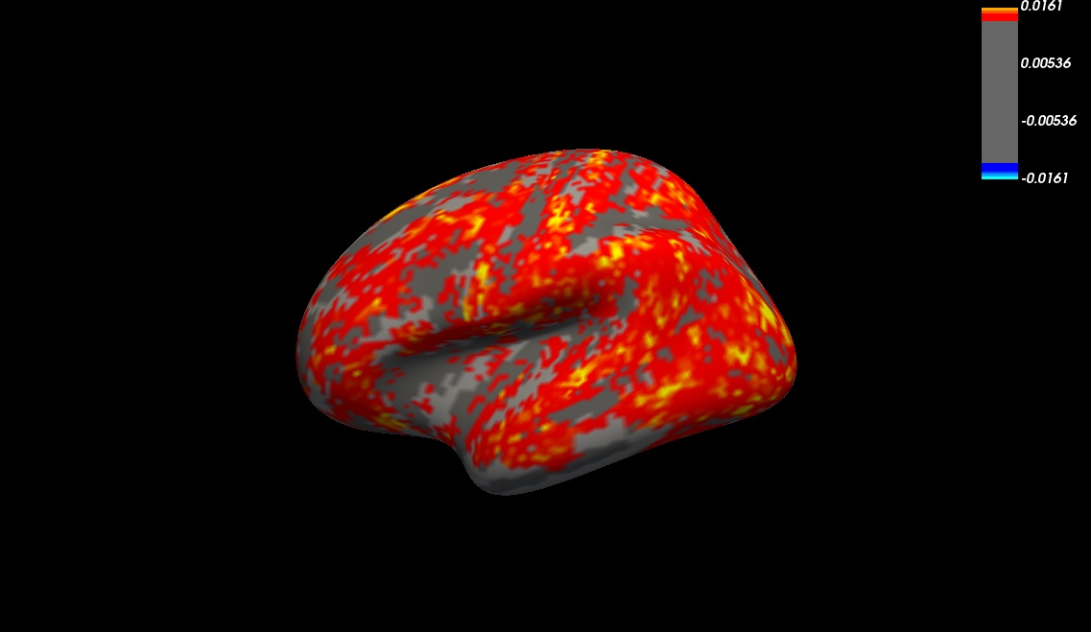
Three-modality, global wcov variance

Slide 7
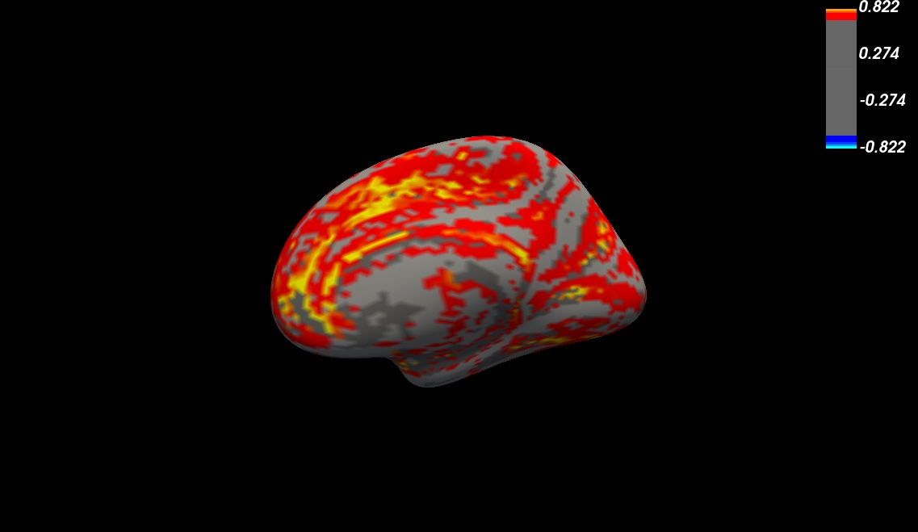
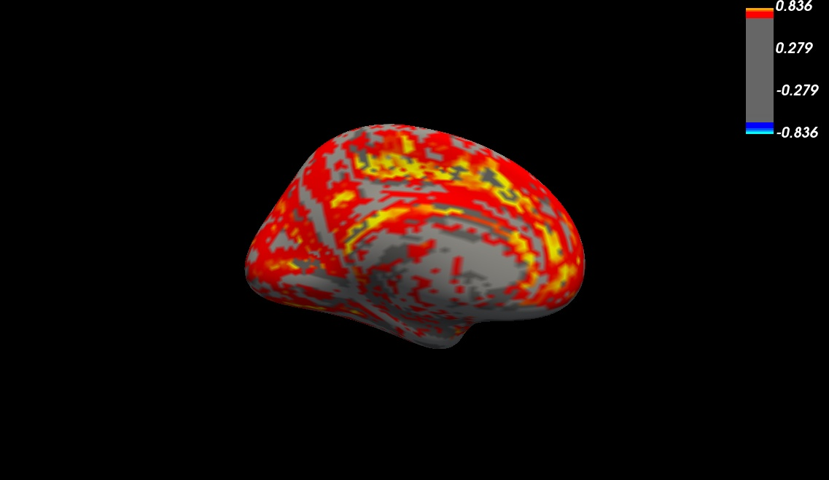

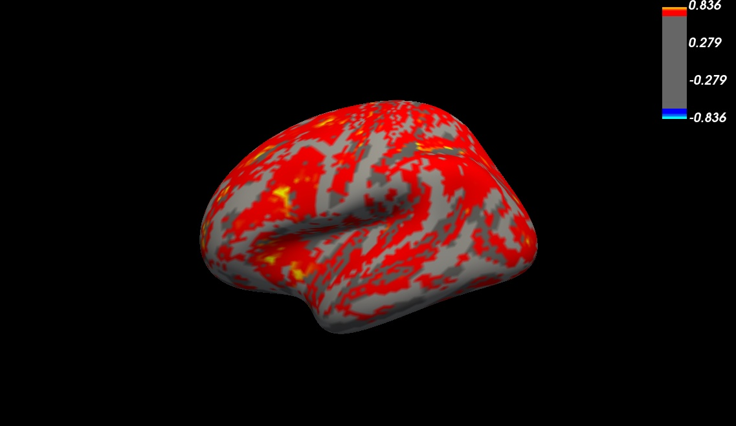
Three-modality, unscaled wcor mean

Slide 8
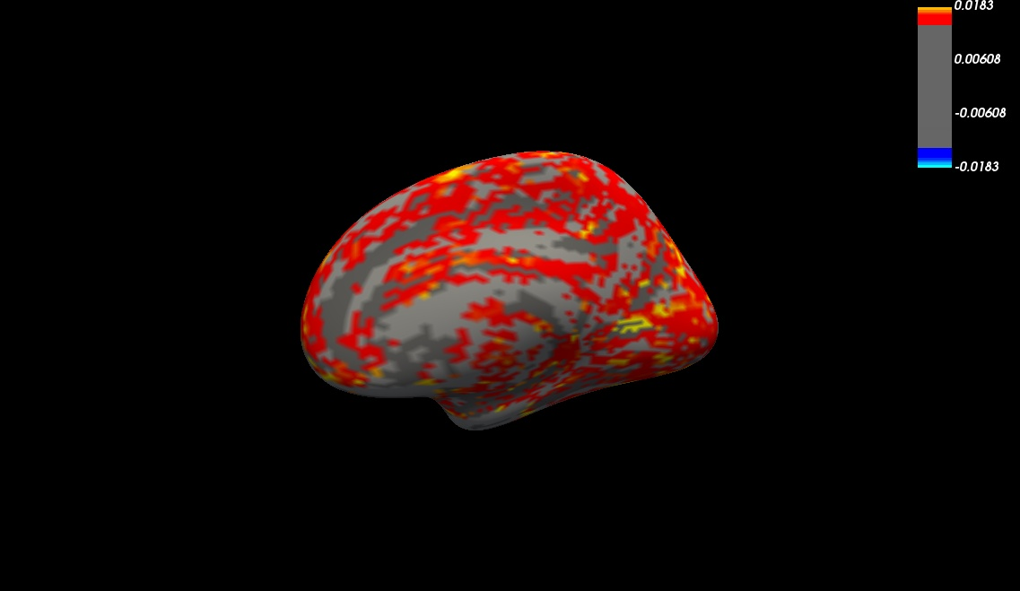
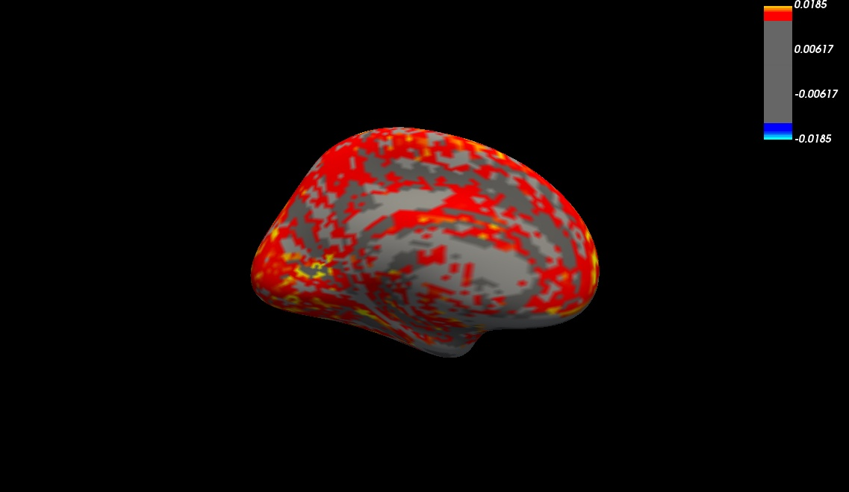
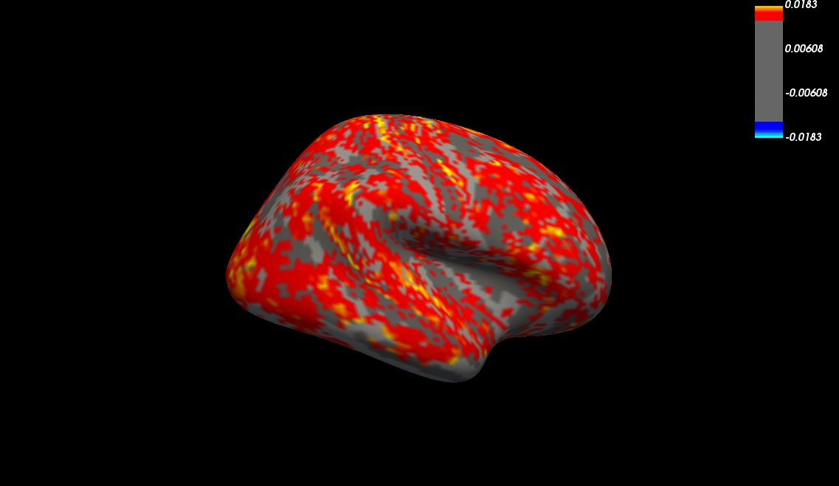

Three-modality, unscaled wcor variance

Slide 9
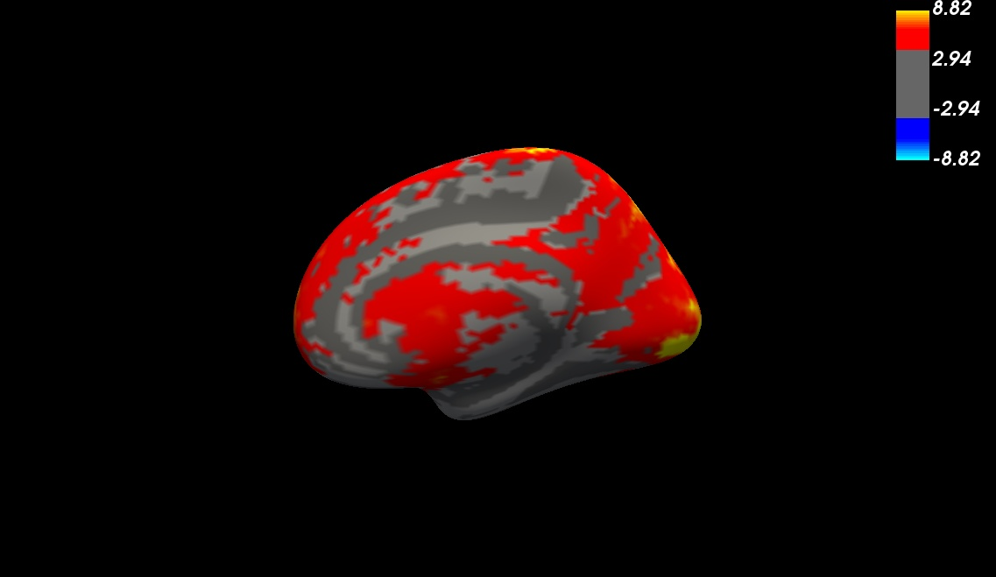
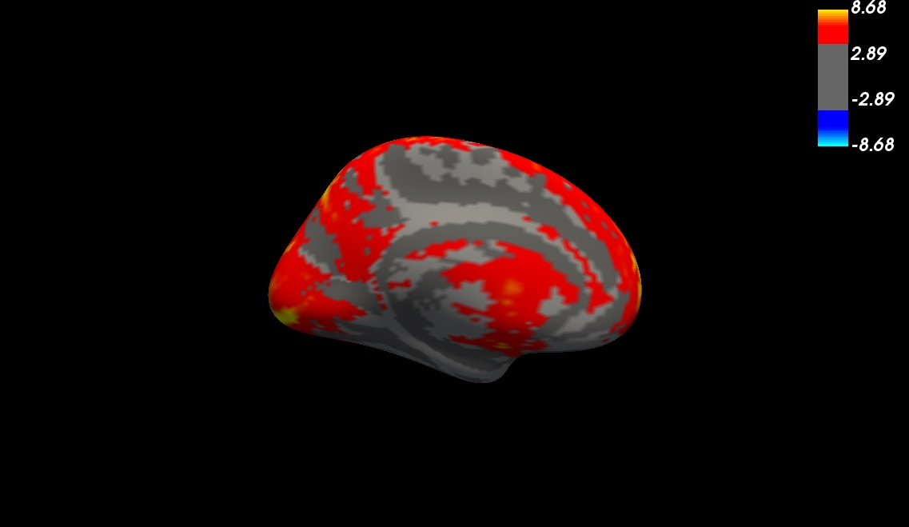
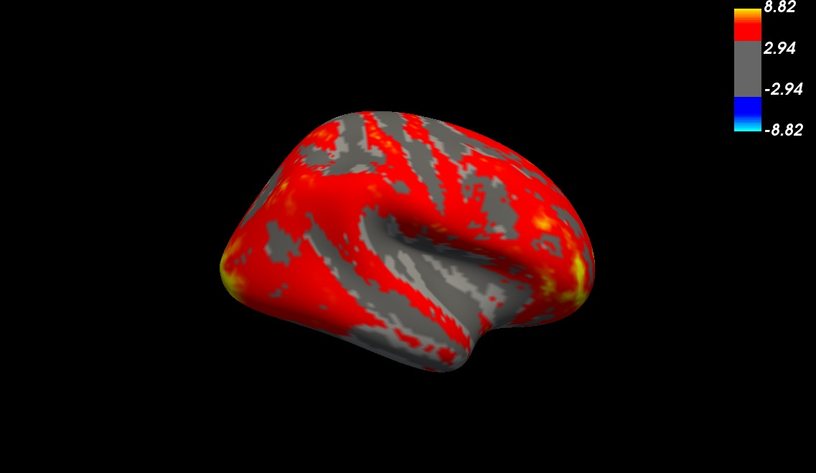
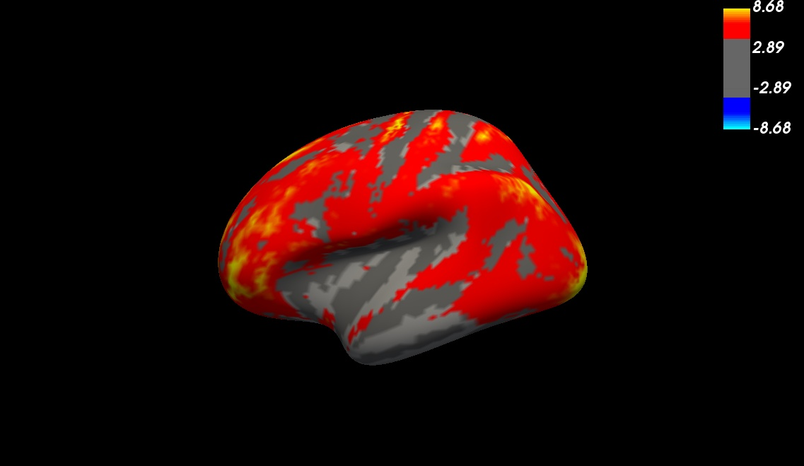
ALFF (normalized average from three-modality pop)

Slide 10
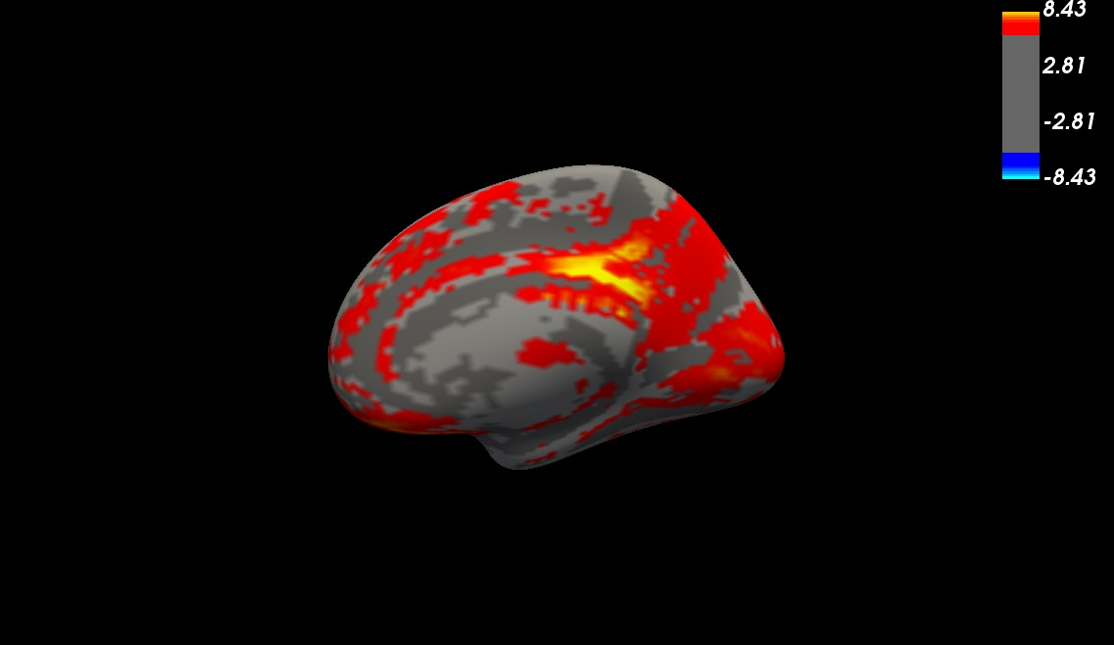
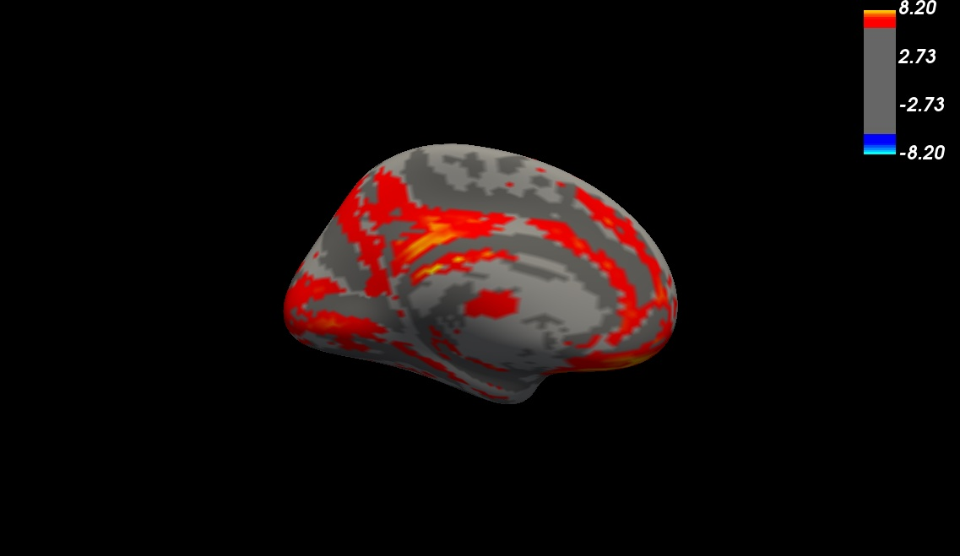
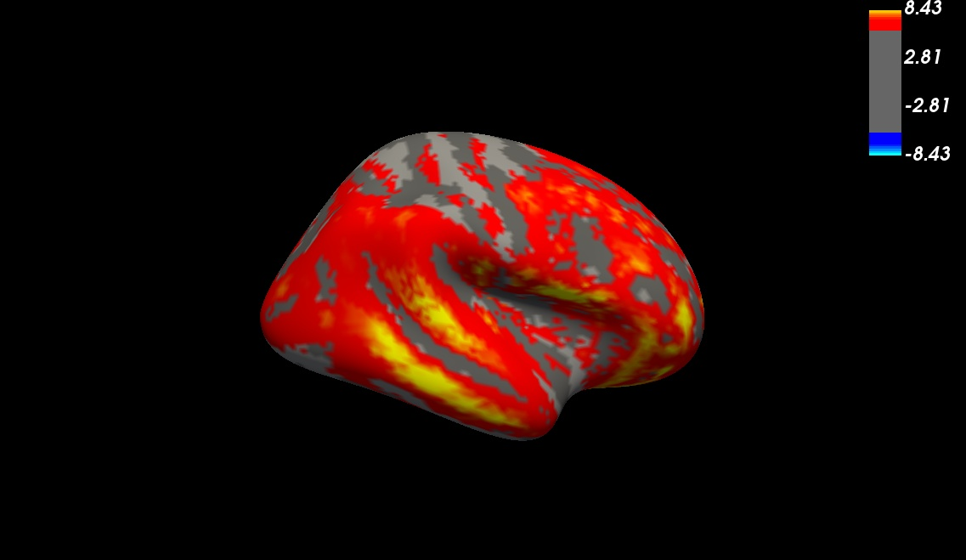
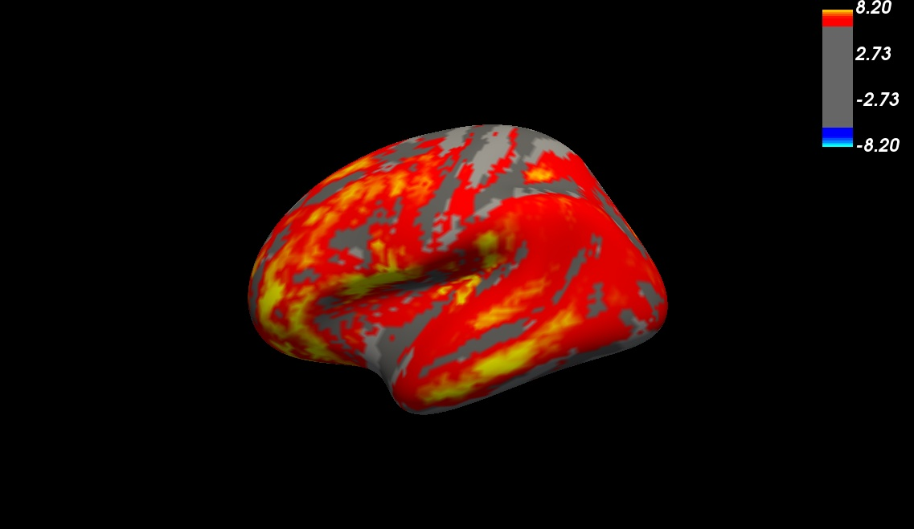
CBF (normalized average from three-modality pop)

Slide 11
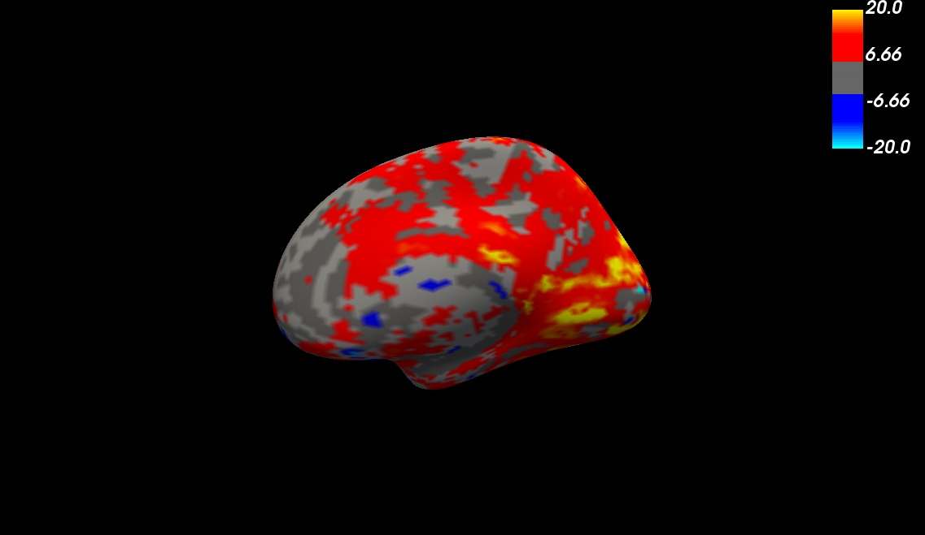
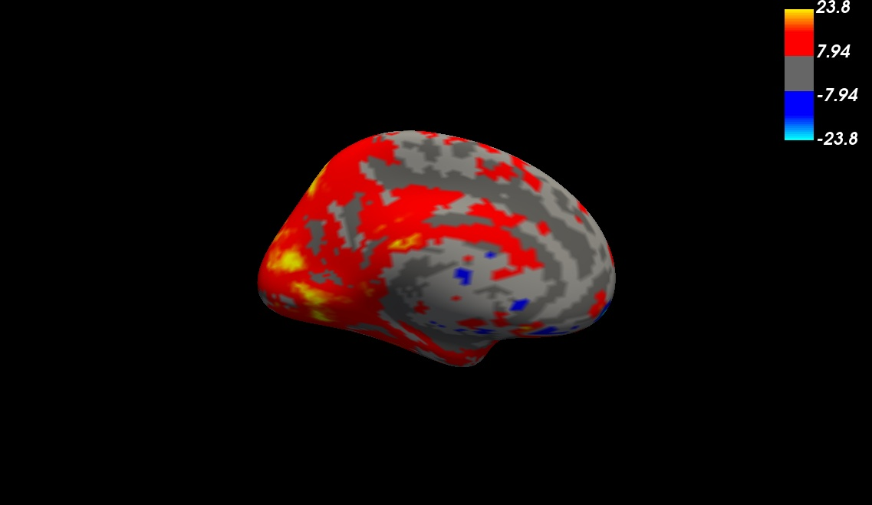
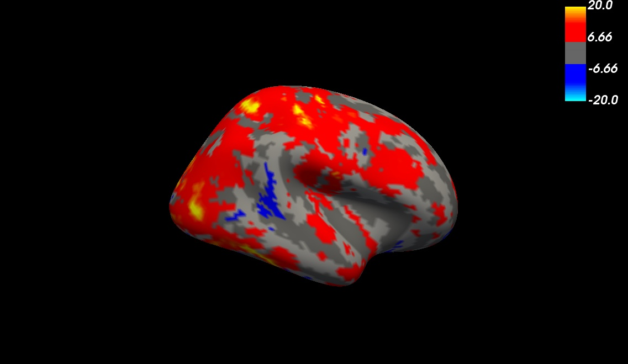
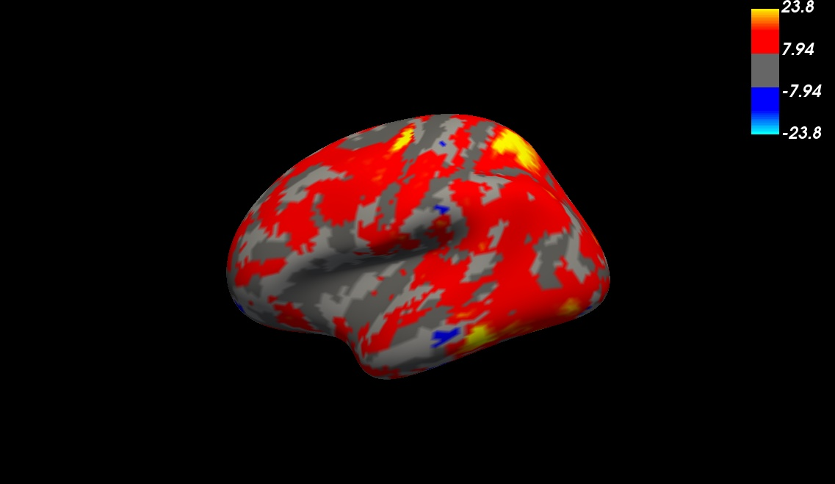
IDEMO (normalized average from three-modality pop)

Slide 12
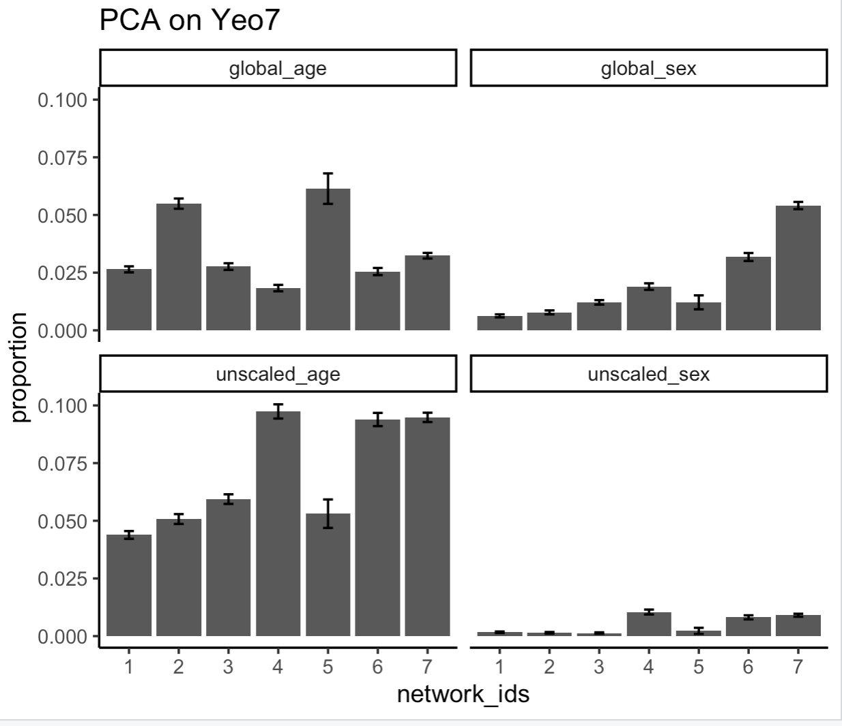
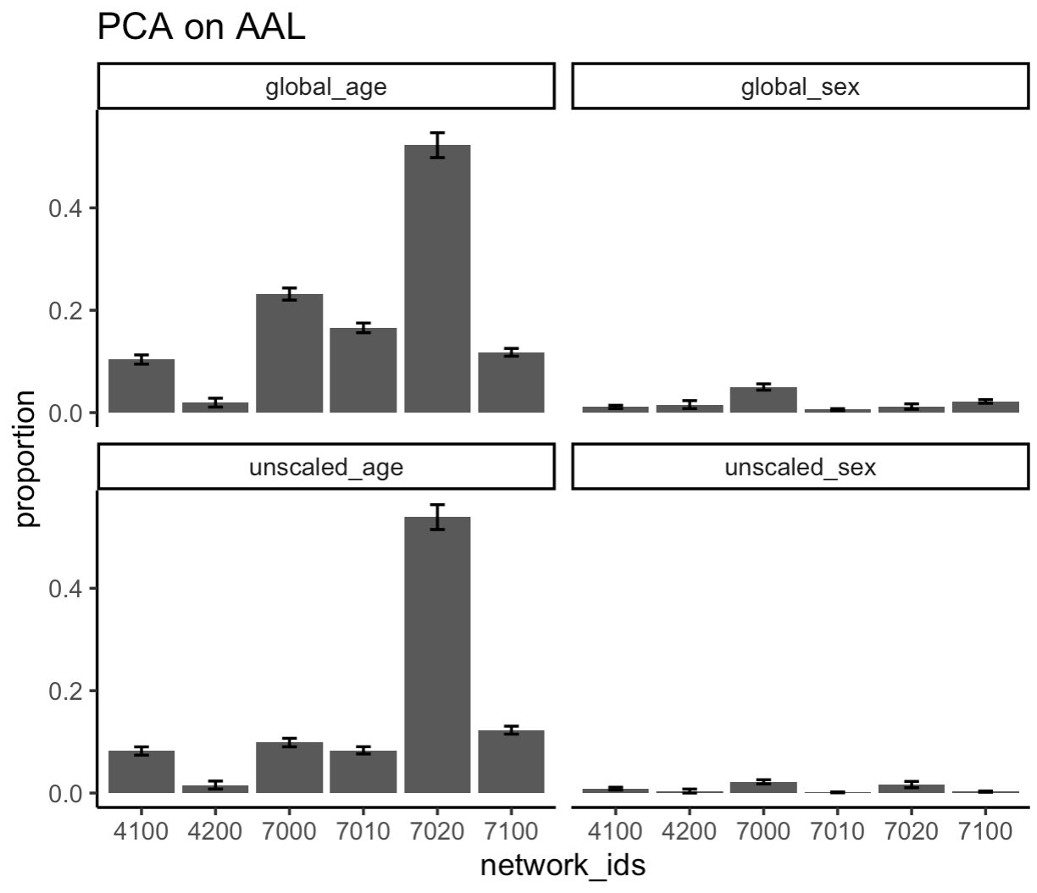
Two-modality, proportion of significant voxels

Slide 13
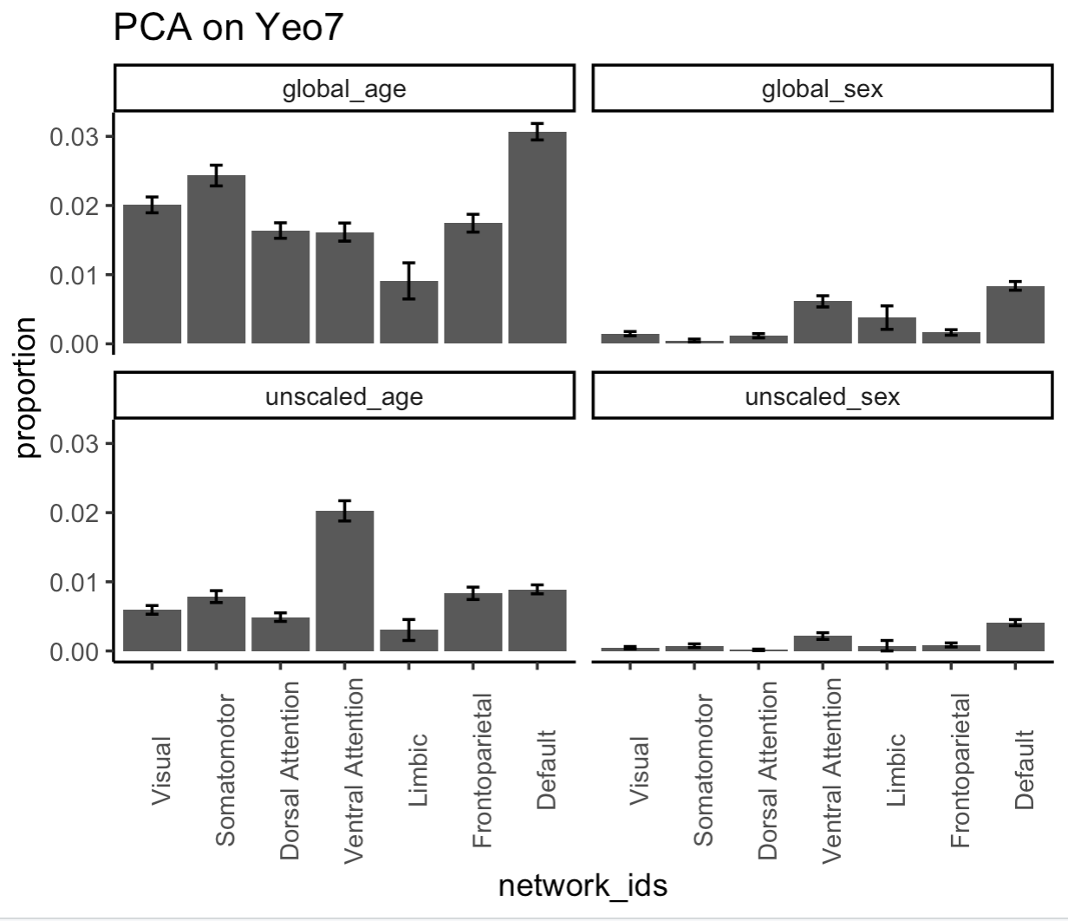
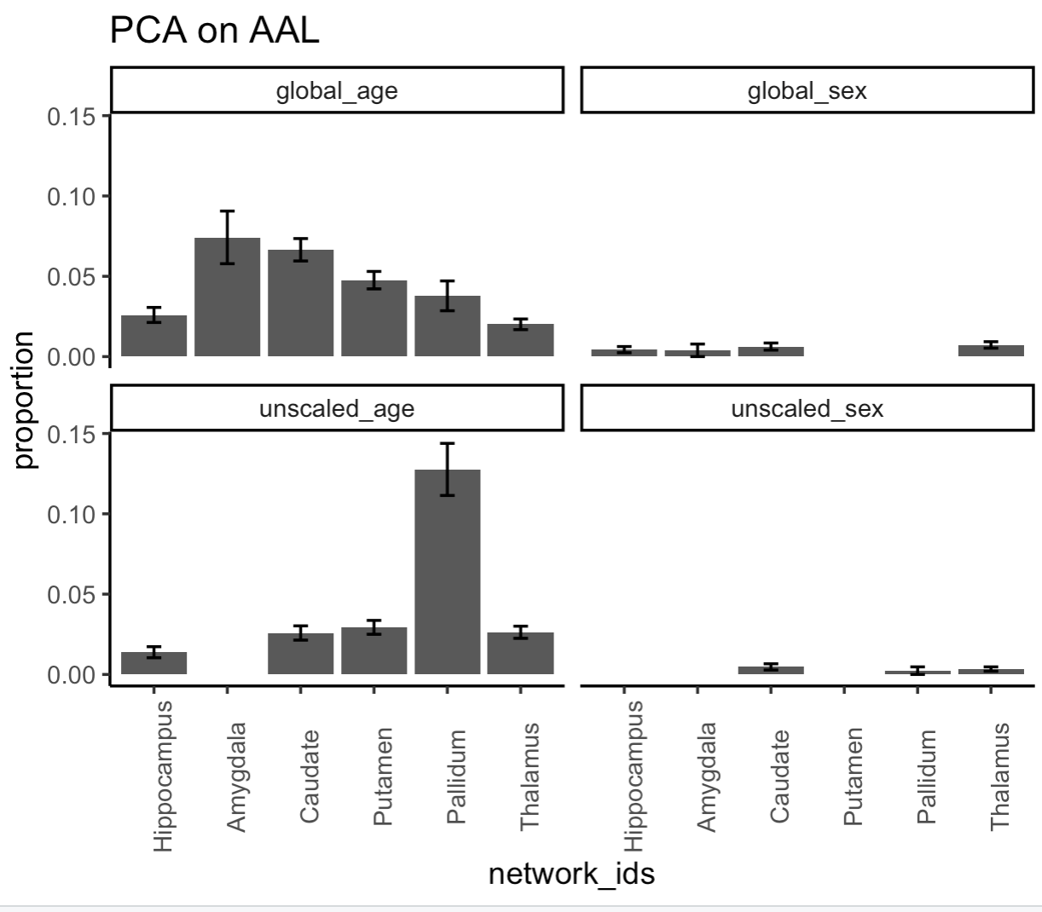
Three-modality, proportion of significant voxels

Slide 14
Spin Test p-values (generated by Sarah Weinstein)
 | Three-modality
Row | unscaled_wcor_sex | unscaled_wcor_age | global_wcov_sex | global_wcov_age
yeo7_1 | 0.702 | 0.651 | 0.597 | 0.407
yeo7_2 | 0.456 | 0.649 | 0.937 | 0.425
yeo7_3 | 0.808 | 0.965 | 0.685 | 0.53
yeo7_4 | 0.121 | 0.029 | 0.169 | 0.672
yeo7_5 | 0.532 | 0.984 | 0.779 | 0.999
yeo7_6 | 0.712 | 0.176 | 0.49 | 0.297
yeo7_7 | 0.108 | 0.356 | 0.137 | 0.174
 | Two-modality
Row | unscaled_wcor_sex | unscaled_wcor_age | global_wcov_sex | global_wcov_age
yeo7_1 | 0.927 | 0.889 | 0.717 | 0.638
yeo7_2 | 0.829 | 0.921 | 0.654 | 0.072
yeo7_3 | 0.803 | 0.683 | 0.599 | 0.554
yeo7_4 | 0.186 | 0.031 | 0.389 | 0.913
yeo7_5 | 0.788 | 0.998 | 0.806 | 0.847
yeo7_6 | 0.312 | 0.223 | 0.372 | 0.348
yeo7_7 | 0.218 | 0.013 | 0.012 | 0.481

